Slide 1
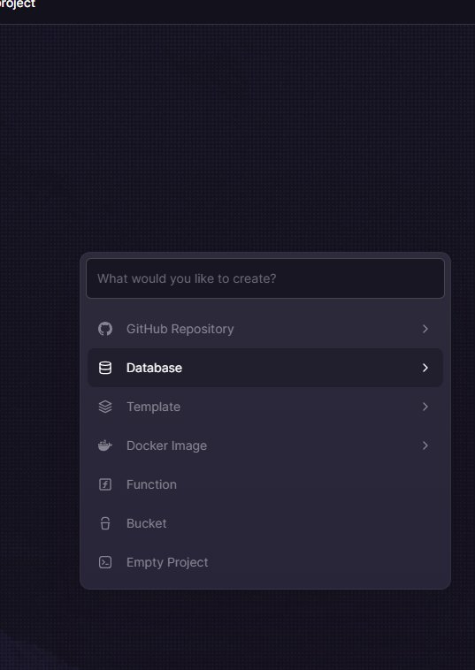
EN
WEEK 05
</>
Data Visualisation & Web Scraping
Using Python's built-in tools and external packages
By the end of this lesson you will be able to:
○ Import and use Python's built-in modules
○ Choose the right chart for the right data
○ Scrape basic web data using requests and BeautifulSoup
codencode.my
Python for Beginners • Week 05 — Data Visualisation & Web Scraping
EN
01

Slide 2
What is a Module?
📖 Pre-written code you can reuse
import_demo.py
A module is a file of Python code written by someone else that you can use in your own program.
Python comes with hundreds of built-in modules — called the Standard Library.
Ways to import:
○ import math
→ use as math.sqrt()
○ from math import sqrt
→ use as sqrt() directly
○ from math import *
→ imports everything (avoid!)
○ import math as m
→ use as m.sqrt() (alias)
import math
from datetime import datetime
import random
# math module
print(math.pi) # 3.14159...
print(math.sqrt(144)) # 12.0
print(math.floor(3.9)) # 3
# datetime module
now = datetime.now()
print(now.year) # 2026
print(now.strftime("%d %B %Y"))
# random module
print(random.randint(1, 100))
codencode.my
Python for Beginners • Week 05 — Data Visualisation & Web Scraping
EN
02

Slide 3
The random Module
📖 Generating random values
random_demo.py
The random module generates random numbers and makes random choices — great for games, simulations and quizzes.
Key functions:
○ random.randint(a, b) → random int between a and b (inclusive)
○ random.random() → float between 0.0 and 1.0
○ random.choice(list) → random item from a list
○ random.shuffle(list) → shuffle list in place
○ random.sample(list,k) → k unique random items
import random
# Dice roller
dice = random.randint(1, 6)
print("You rolled:", dice)
# Random name picker
students = ["Aisha","Wei Jie","Siti","Rajan"]
picked = random.choice(students)
print("Today's presenter:", picked)
# Shuffle a quiz order
questions = ["Q1","Q2","Q3","Q4","Q5"]
random.shuffle(questions)
print("Quiz order:", questions)
# Lucky 2 from class
lucky = random.sample(students, 2)
print("Lucky pair:", lucky)
codencode.my
Python for Beginners • Week 05 — Data Visualisation & Web Scraping
EN
03

Slide 4
The datetime Module
datetime_demo.py
from datetime import datetime, date, timedelta
# Current date and time
now = datetime.now()
print("Now: ", now)
print("Year: ", now.year)
print("Month:", now.month)
print("Day: ", now.day)
# Formatted strings
print(now.strftime("%d/%m/%Y")) # 11/03/2026
print(now.strftime("%A, %d %B %Y")) # Wednesday, 11 March 2026
print(now.strftime("%I:%M %p")) # 10:30 AM
# Date arithmetic
today = date.today()
next_class = today + timedelta(days=7)
print("Next class:", next_class)
# Days until an event
event = date(2026, 12, 31)
delta = event - today
print("Days until NYE:", delta.days)
💡 What this does:
strftime() formats dates as strings. %d=day, %m=month, %Y=4-digit year, %A=weekday name, %B=month name. timedelta lets you add/subtract days, weeks, hours from dates.
codencode.my
Python for Beginners • Week 05 — Data Visualisation & Web Scraping
EN
04

Slide 5
The math Module
math_demo.py
import math
# Basic math functions
print(math.sqrt(144)) # 12.0
print(math.pow(2, 10)) # 1024.0
print(math.floor(3.9)) # 3
print(math.ceil(3.1)) # 4
print(math.abs(-15)) # 15 — use abs() directly
# Constants
print(math.pi) # 3.141592653589793
print(math.e) # 2.718281828459045
# Circle area calculator
def circle_area(radius):
return math.pi * radius ** 2
print(f"Area (r=5): {circle_area(5):.2f}") # 78.54
# Logarithm
print(math.log(100, 10)) # 2.0 (log base 10)
print(math.log(math.e)) # 1.0 (natural log)
💡 What this does:
math provides exact implementations of mathematical functions. math.sqrt() is faster and more precise than ** 0.5 for roots. Use math.pi instead of hardcoding 3.14.
codencode.my
Python for Beginners • Week 05 — Data Visualisation & Web Scraping
EN
05

Slide 6
Useful Built-in Modules
rnd
random
dt
datetime
randint, choice, shuffle, sample. Use for games, quizzes, simulations and picking random items from lists.
datetime.now(), date.today(), timedelta. Use for timestamps, countdowns, scheduling and formatting dates.
mth
math
os
os
sqrt, pi, floor, ceil, pow, log. Use for geometry, statistics and any calculation beyond basic arithmetic.
os.path.exists(), os.listdir(), os.getcwd(). Use for checking files, listing directories and working with file paths.
codencode.my
Python for Beginners • Week 05 — Data Visualisation & Web Scraping
EN
06

Slide 7
The os Module — Working with Paths
os_demo.py
import os
# Current working directory
print(os.getcwd()) # /home/user/projects
# Check if file/folder exists
print(os.path.exists("contacts.csv")) # True or False
# List files in a directory
files = os.listdir(".")
for f in files:
print(f)
# Build file paths safely (works on Windows + Mac/Linux)
folder = "data"
filename = "scores.csv"
full_path = os.path.join(folder, filename)
print(full_path) # data/scores.csv or data\scores.csv
# Create a folder if it doesn't exist
if not os.path.exists("backups"):
os.makedirs("backups")
print("Created backups folder")
💡 What this does:
os.path.join() builds file paths that work on all operating systems — Windows uses backslash, Mac/Linux use forward slash. Always use it instead of hardcoding / or \.
codencode.my
Python for Beginners • Week 05 — Data Visualisation & Web Scraping
EN
07

Slide 8
Building a Number Guessing Game
guess_game.py
import random
from datetime import datetime
def play_game():
secret = random.randint(1, 100)
attempts = 0
max_tries = 7
start = datetime.now()
print("🎮 Guess the number (1-100)!")
print(f"You have {max_tries} attempts.
")
while attempts < max_tries:
guess = int(input("Your guess: "))
attempts += 1
if guess < secret:
print("📈 Too low!")
elif guess > secret:
print("📉 Too high!")
else:
elapsed = (datetime.now() - start).seconds
print(f"🎉 Correct! In {attempts} tries, {elapsed}s!")
return
print(f"💀 Out of tries! It was {secret}.")
play_game()
💡 What this does:
random.randint() picks the secret number once at the start. datetime tracks how long the game took. This combines modules, loops, functions and conditionals into one real program.
codencode.my
Python for Beginners • Week 05 — Data Visualisation & Web Scraping
EN
08

Slide 9
Installing External Libraries with pip
📖 Beyond the Standard Library
pip_usage.py
Python's real power comes from thousands of third-party libraries.
Install them using pip (Python's package manager):
pip install library_name
Popular libraries you'll use later:
○ numpy — fast number arrays
○ pandas — data tables
○ matplotlib — charts and graphs
○ requests — web/API calls
○ flask — web apps
Once installed, import them the same way as built-in modules.
# In Terminal / Command Prompt:
# pip install requests
# Then in your Python file:
import requests
# Make a web request
response = requests.get(
"https://api.github.com"
)
print(response.status_code) # 200
print(type(response.json())) # <class 'dict'>
# Check installed packages:
# pip list
# pip show requests
# pip uninstall requests
codencode.my
Python for Beginners • Week 05 — Data Visualisation & Web Scraping
EN
09

Slide 10
Building Your Own Module
my_utils.py
# ── my_utils.py — your own reusable module ──
def get_grade(score):
"""Return grade letter for a numeric score."""
if score >= 90: return "A"
elif score >= 75: return "B"
elif score >= 60: return "C"
else: return "F"
def average(numbers):
"""Return the arithmetic mean of a list."""
if not numbers:
return 0
return sum(numbers) / len(numbers)
def format_ringgit(amount):
"""Format a float as Malaysian Ringgit."""
return f"RM {amount:,.2f}"
# ── main.py — using your module ──────────
# from my_utils import get_grade, average
# scores = [85, 92, 61, 78]
# for s in scores:
# print(get_grade(s))
# print(average(scores)) # 79.0
# print(format_ringgit(1999.5)) # RM 1,999.50
💡 What this does:
You can create your own modules! Any .py file is importable. Put commonly used functions in utils.py, then import them in other files. Docstrings (triple quotes) document what each function does.
codencode.my
Python for Beginners • Week 05 — Data Visualisation & Web Scraping
EN
10

Slide 11
🧠 Quiz Time!
Q:
What is the difference between "import random" and "from random import randint"?
A
They are identical — just different styles with no practical difference
B
import random loads the whole module; you access with random.randint(). from random import randint imports only that function; use as randint() directly
C
from random import randint is slower because it imports more code
D
import random only works in Python 3; from random import is Python 2 style
codencode.my
Python for Beginners • Week 05 — Data Visualisation & Web Scraping
EN
11

Slide 12
Practical: Attendance Logger
attendance.py
import os
from datetime import datetime
LOG_FILE = "attendance.log"
def log_attendance(name):
timestamp = datetime.now().strftime("%Y-%m-%d %H:%M:%S")
with open(LOG_FILE, "a") as f:
f.write(f"{timestamp},{name}
")
print(f"✅ {name} logged at {timestamp}")
def view_today():
today = datetime.now().strftime("%Y-%m-%d")
if not os.path.exists(LOG_FILE):
print("No attendance records yet.")
return
with open(LOG_FILE, "r") as f:
lines = f.readlines()
today_entries = [l for l in lines if l.startswith(today)]
print(f"── Attendance {today} ──")
for entry in today_entries:
ts, name = entry.strip().split(",")
print(f" {ts[11:]} {name}")
log_attendance("Aisha")
view_today()
💡 What this does:
This real-world logger combines datetime for timestamps, os to check file existence, and file I/O to persist records. Notice today's entries are filtered with a list comprehension.
codencode.my
Python for Beginners • Week 05 — Data Visualisation & Web Scraping
EN
12

Slide 13
⌨️ Try It Yourself
📋 Build a Study Timer & Quiz Picker
🏆 XP Reward
1. Use datetime to show today's date and a welcome message at startup
2. Create a list of 10 quiz questions (just strings — e.g. 'What does len() do?')
3. Use random.sample() to pick 5 random questions each run
4. Use random.shuffle() to randomise the order before displaying
5. Track the start time; when done use timedelta to print how long the quiz took
6. Bonus: Use random.randint() to assign XP (10–50) for each correct answer
80 XP
⏱ Time Limit
25 min
Expected output:
📅 Today: Wednesday, 11 March 2026
🎯 5 random questions selected
Q1: What does len() do?
...
⏱ Time taken: 0:03:42
🏆 Total XP earned: 180
codencode.my
Python for Beginners • Week 05 — Data Visualisation & Web Scraping
EN
13

Slide 14
⌨️ Try It Yourself
📋 Extension: Daily Journal with Timestamps
🏆 XP Reward
1. Use datetime.now().strftime() to generate timestamps for each entry
2. Save entries to a file: 'YYYY-MM-DD HH:MM:SS | entry text'
3. Add a view command: filter and display only today's entries
4. Add a stats command: use len() to count entries, show oldest entry date
5. Bonus: Use os.path.getsize() to display the file size
40 XP
⏱ Time Limit
15 min
Expected output:
1. Write entry
2. View today
3. Stats
> 3
Total entries: 7
File size: 412 bytes
First entry: 2026-03-05
codencode.my
Python for Beginners • Week 05 — Data Visualisation & Web Scraping
EN
14

Slide 15
Lesson Summary
✅ What we learned today
🔍 Next Week
○ Modules are reusable files of Python code — import to use them
Week 6: Final Project
You'll build a complete Python program of your choice combining all 5 weeks of skills. Plan, build, test and present.
○ random: randint, choice, shuffle, sample for randomness
○ datetime: now(), strftime(), timedelta for dates and times
○ math: sqrt, pi, floor, ceil for advanced calculations
○ pip installs third-party libraries — you'll use this every day as a developer
📝 This Week's Assignment
110 XP
Build the Study Timer & Quiz Picker. Must use random and datetime modules. Include at least 3 module functions. Submit .py file on the LMS.
codencode.my
Python for Beginners • Week 05 — Data Visualisation & Web Scraping
EN
15

